Slide 1
Disruptive Technologies, AI, and Democracy: A Rising Threat to Global Elections
Demetris Skourides
Chief Scientist for Research, Innovation and Technology
Educational Activity UNIC MUN - Nicosia, November 24, 2024

Slide 2
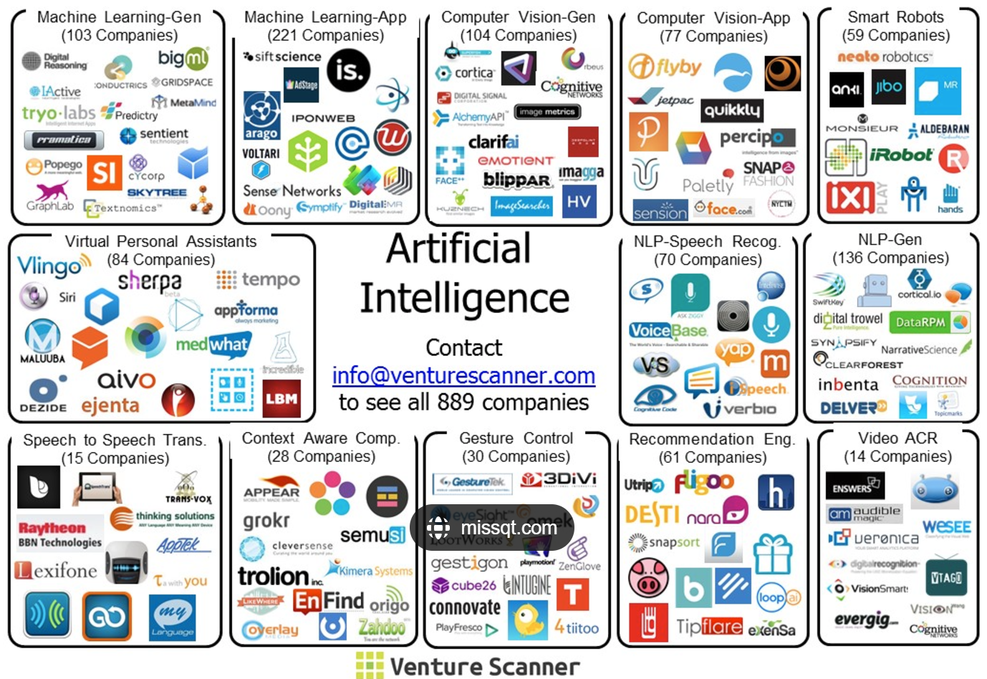
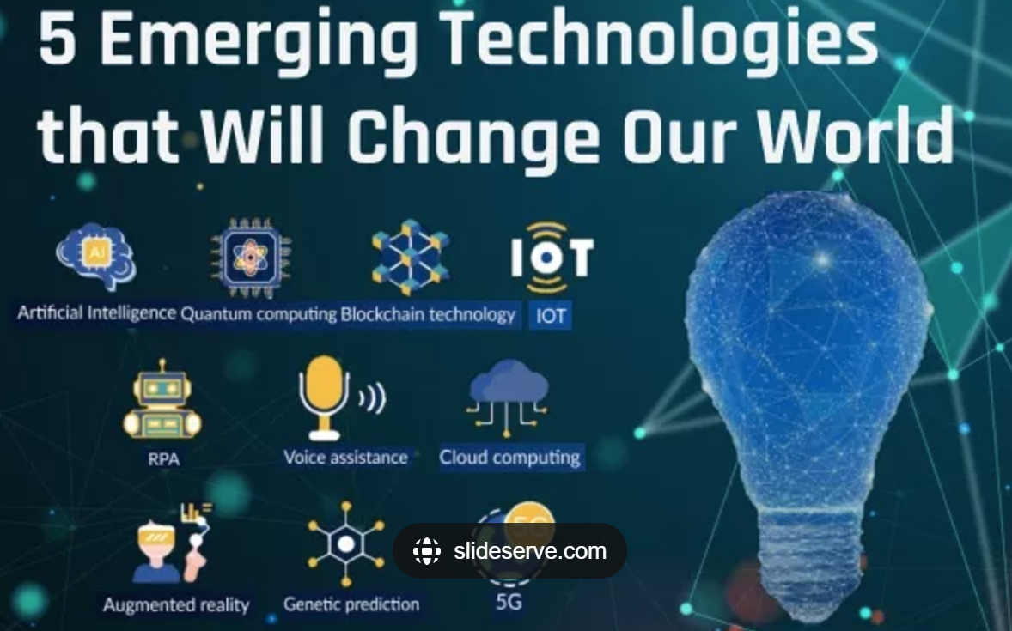
Emerging Technologies

Slide 3
Democracy at a Crossroads
Technology’s dual role in shaping democratic systems
Positive
Enhanced Civic Engagement
Negative
Disinformation and Manipulation
Transparent Governance
Wider Access to Information
Data Exploitation
Digital Divide

Slide 4
Timeline showing major AI milestones in election processes
U.S. Presidential Campaign: AI used for voter microtargeting based on social media data, influencing campaign strategies.
2012
AI-Driven Disinformation:
Widespread use of AI bots to amplify fake news during U.S. elections, significantly affecting voter opinions.
2016
Blockchain Voting in Sierra Leone
First use of blockchain and AI to ensure transparency and reduce fraud in vote tallying.
2018
2020
Deepfake Detection Tools
Efforts to combat deepfakes and AI-generated misinformation intensify during U.S. elections.
2024
Real-Time Campaign AdjustmentsAI tools enable dynamic voter engagement and sentiment analysis, reshaping modern campaign strategies.

Slide 5
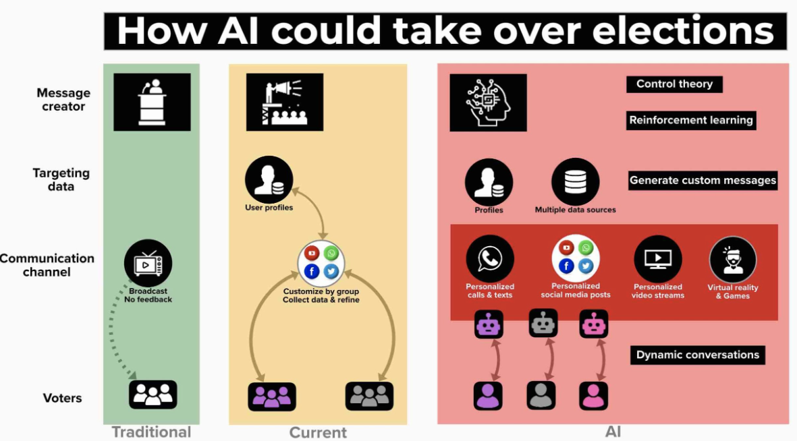
How AI Could Take Over Elections
An AI-driven political campaign could be all things to all people" by Archon Fung, Professor of Citizenship and Self-Government, Harvard Kennedy School and Lawrence Lessig, Professor of Law and Leadership, Harvard University.
Source: How AI Could Take Over Elections

Slide 6
The Power of AI in Elections - Opportunities for Electoral Integrity
Real-Time Fraud Detection: AI reduces ballot tampering (e.g., India's Election Commission pilot program in 2021).
Voter Engagement: Tailored outreach campaigns improve inclusivity.
Secure Infrastructure: AI monitors and prevents cyberattacks on election systems.
In the 2020 U.S. elections, AI flagged over 2 million potentially false voting claims, contributing to enhanced transparency.

Slide 7
The Rising Threats of AI Misuse - Democracy Under Attack
Deepfake Technology
900% rise in usage since 2020 (Oxford report).
Impact: Fake videos of candidates can alter public opinion.
Example: Deepfake videos targeting U.S. presidential candidates went viral during 2020 elections
Disinformation Campaigns
Automated bots produce over 10 million fake posts daily (Security.org).
Example: False narratives about voter fraud influenced 70% of online discussions in 2020.

Slide 8
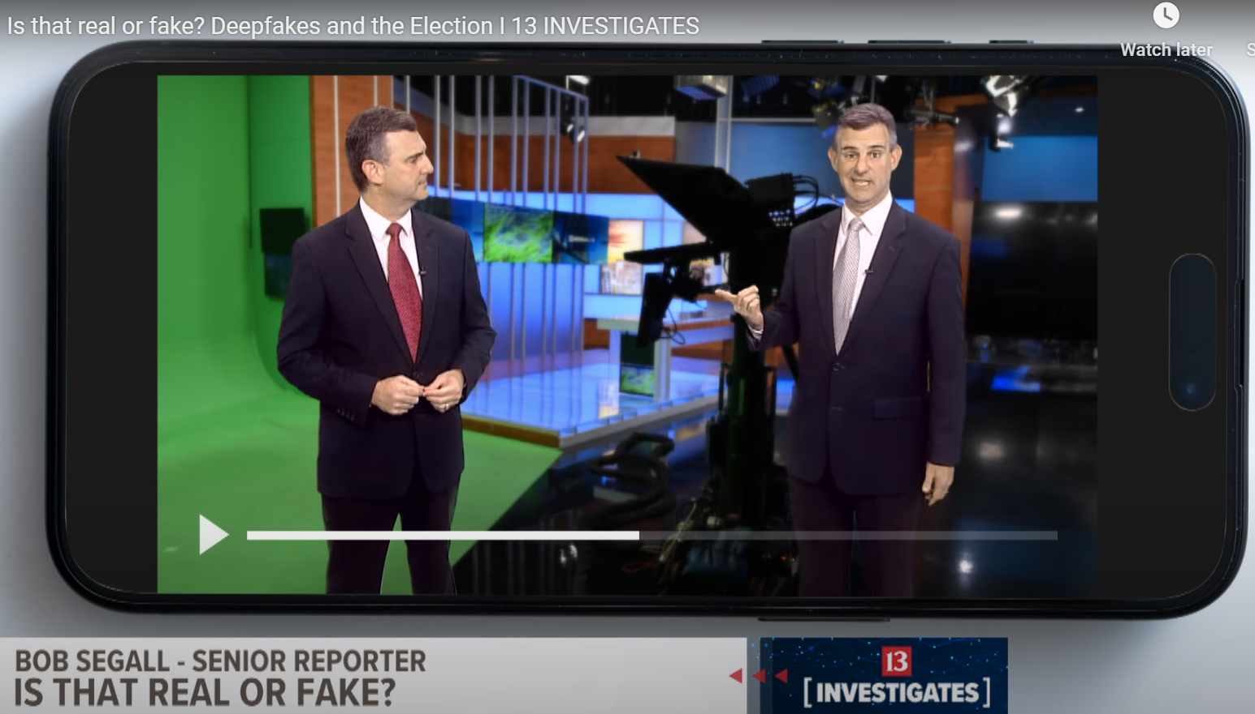
How big is the risk?

Slide 9
Global Impact of AI in Elections - The Worldwide Perspective
U.S:
60% of U.S. voters engaged with AI-generated political content during campaigns (Freedom House).
Europe:
80% of political parties in the EU faced AI-driven cyber threats (European Commission).
Germany’s 2021 elections saw 12% of online discourse manipulated by bots.
Asia and Africa:
Social media misinformation campaigns disrupted elections in India and Kenya.

Slide 10
Cyprus’s Position on the Global Stage
Leading by Example

Slide 11
Cyprus’s Position on the Global Stage - Leading by Example
Regulatory Strength
Innovation Ecosystem
Education
Implementation of the National AI Strategy.
Cyprus has committed significant resources to advance AI, with an approved national strategy focusing on ethical development
Research projects funded by the Research & Innovation Foundation.
Cyprus’s participation in Horizon Europe programs for secure elections.
Promoting AI ethics in schools to build awareness.
AI-conversational assistant to provide personalized education

Slide 12
Ethical Considerations - Balancing Innovation and Integrity
Transparency
Ensuring AI algorithms in elections are explainable
Bias Reduction
Using inclusive datasets for training AI
Accountability
Holding creators of malicious AI tools responsible
Example: The EU’s AI Act, with Cyprus contributing to its enforcement.

Slide 13
Recommendations for Safeguarding Democracy - Charting a Path Forward
Global Cooperation
Joint cybersecurity task forces for election monitoring.
Establishing international AI standards
Public Awareness
Campaigns to educate voters about disinformation.
Partnerships with media to debunk deepfakes in real time.
Advanced Technologies:
Developing AI tools to counter AI-generated disinformation.
Strengthening digital literacy programs globally.

Slide 14
Looking Ahead – A Call to Action
“The integrity of democracy depends on our collective vigilance and innovation.”
Cyprus will continue leading efforts in ethical AI, setting an example globally.
AI must serve democracy, not undermine it.

Slide 15
Thank you

